Slide 1

INDIA NATIONAL FAMILY HEALTH SURVEY (NFHS-5) ANALYSIS
A Data-Driven View of India’s Literacy, Health & Nutrition
BY TEAM 24KARAT
TEAM MEMBERS NAME - SUBHASMITA KAR, ADITYA GOCHHAYAT, SOURAV PATRA,SK MUDASSIR NAWAZ, NADIKA NIKHIL REDDY

Slide 2

Objectives & Rationale
OBJECTIVE:
TO ANALYZE INDIA’S DISTRICT-LEVEL AND STATE LEVEL DATA FROM THE NFHS-5 SURVEY TO IDENTIFY TRENDS AND GAPS IN KEY SOCIAL INDICATORS SUCH AS LITERACY, HEALTH, AND NUTRITION.
RATIONALE:
INDIA’S NFHS-5 PROVIDES A RICH DATASET FOR UNDERSTANDING PUBLIC WELFARE.
OUR AIM WAS TO CONVERT THIS LARGE DATASET INTO ACTIONABLE INSIGHTS THROUGH POWER BI DASHBOARDS.
FOCUS AREAS: EDUCATION ACCESS, GENDER LITERACY, CHILD & MATERNAL HEALTH, NUTRITION, ANAEMIA, AND CLEAN ENERGY USE.

Slide 3

Dashboard Design & Approach
APPROACH:
DESIGNED THREE FOCUSED DASHBOARDS IN POWER BI TO TURN RAW NFHS-5 DATA INTO MEANINGFUL PATTERNS.
DASHBOARD STRUCTURE:
DEMOGRAPHICS & LITERACY OVERVIEW
LITERACY BY STATE & DISTRICT
GENDER LITERACY COMPARISON
TOP 10 LITERATE DISTRICTS
EDUCATION ACCESS VS. POPULATION
HEALTH & NUTRITION DASHBOARD
MATERNAL AND CHILD HEALTH
IMMUNIZATION AND INSTITUTIONAL BIRTHS
ANAEMIA AMONG WOMEN AND CHILDREN
NUTRITION AND OUT-OF-POCKET EXPENDITURE
SUMMARY DASHBOARD
KEY KPIS: LITERACY RATE, CLEAN FUEL USAGE, INSTITUTIONAL BIRTHS
DESIGN FOCUS:
CLARITY • SIMPLICITY • INTERACTIVITY • POLICY RELEVANCE

Slide 4


Key Insights & Findings
HEALTH & NUTRITION
INSTITUTIONAL BIRTHS: 88.6% (STRONG IMPROVEMENT).
ANAEMIA: FOUND IN OVER 50% OF WOMEN AGED 15–49.
CHILD MALNUTRITION HIGHER IN EASTERN & CENTRAL INDIA.
IMMUNIZATION COVERAGE GENERALLY STRONG BUT UNEQUAL.
CLEAN ENERGY USE
ONLY 39.3% HOUSEHOLDS USE CLEAN COOKING FUEL — LARGE RURAL GAP.
EDUCATION & DEMOGRAPHICS
KERALA AND MIZORAM TOP LITERACY; BIHAR AND UP LAG.
AVERAGE LITERACY RATE: 71.5%
PERSISTENT GENDER LITERACY GAP IN NORTHERN STATES.

Slide 5

Proven Solution & Impact
WE DEVELOPED A POWER BI DASHBOARD SYSTEM THAT CONVERTS NFHS-5 DATA INTO ACTIONABLE INSIGHTS AT STATE AND DISTRICT LEVELS.
SIMPLIFIED 130+ INDICATORS INTO A VISUAL DECISION-SUPPORT TOOL.
HELPS POLICYMAKERS TRACK LITERACY, HEALTH, AND NUTRITION GOALS.
ENABLES COMPARISON BETWEEN STATES TO ALLOCATE RESOURCES EFFICIENTLY.
BUILDS FOUNDATION FOR DATA-DRIVEN GOVERNANCE.
IMPACT EXAMPLE:
DISTRICT ADMINISTRATORS CAN USE THIS DASHBOARD TO IDENTIFY:
LOW FEMALE LITERACY AREAS FOR EDUCATION DRIVES.
HIGH ANAEMIA PREVALENCE FOR TARGETED HEALTH CAMPS.
RURAL ZONES WITH POOR CLEAN-FUEL ACCESS FOR SUBSIDY FOCUS.

Slide 6

Conclusion & Learning Summary
OUR PROJECT DEMONSTRATES HOW OPEN GOVERNMENT DATA LIKE NFHS-5 CAN BE TURNED INTO ACTIONABLE INTELLIGENCE THROUGH MODERN ANALYTICS TOOLS.
BY BRIDGING THE GAP BETWEEN DATA AND DECISION-MAKING, OUR DASHBOARD SUPPORTS INCLUSIVE AND EVIDENCE-BASED DEVELOPMENT.
KEY LEARNINGS:
DATA CLEANING AND VISUALIZATION USING POWER BI.
DASHBOARD STORYTELLING FOR SOCIAL IMPACT.
IMPORTANCE OF COLLABORATION AND INTERPRETATION IN ANALYTICS.

Slide 7
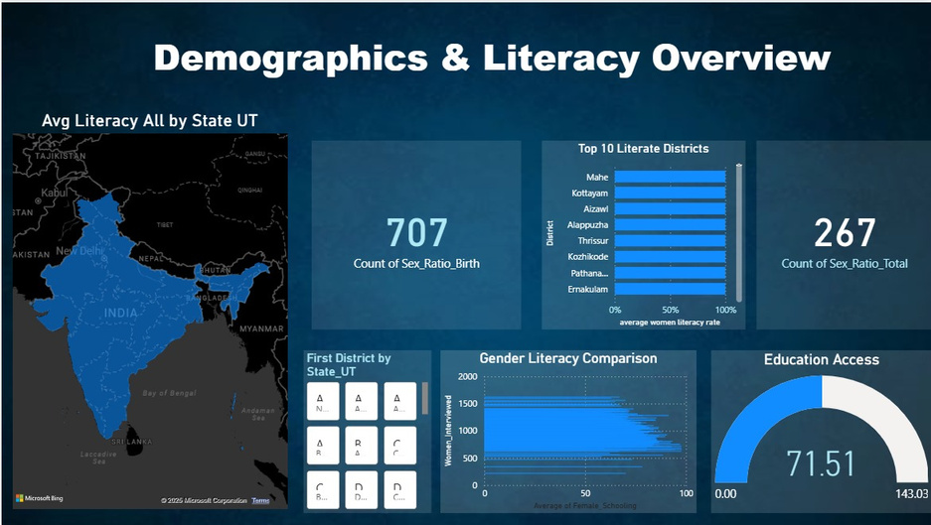
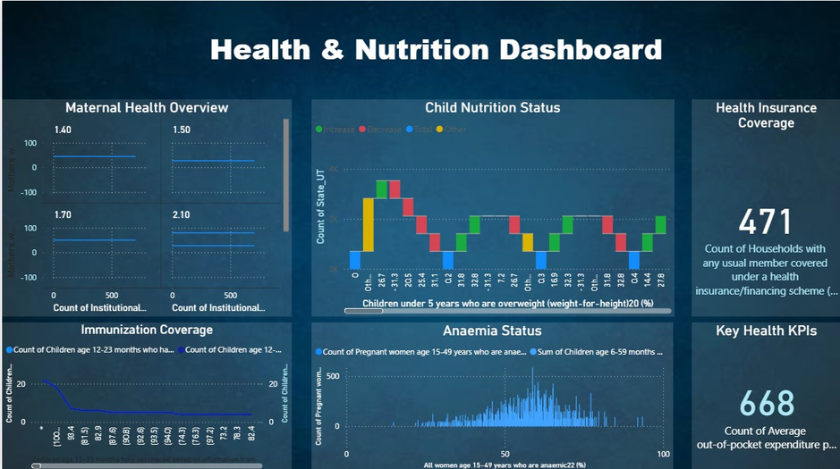
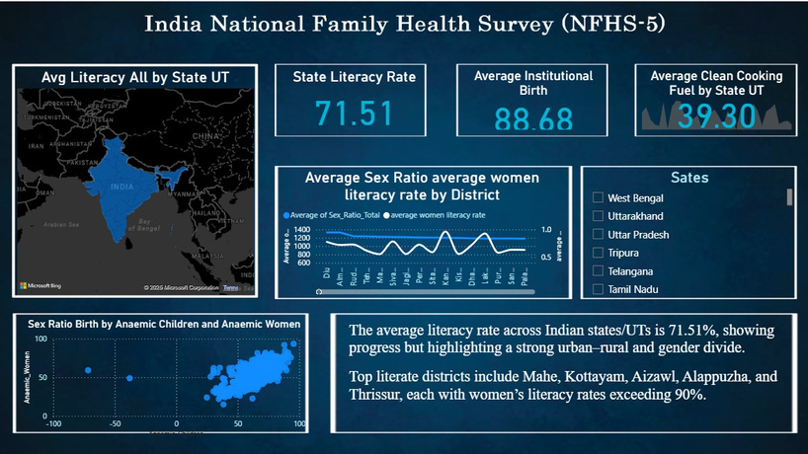
Dashboard Visuals
THE DASHBOARD FOLLOWS A PROFESSIONAL ANALYTICAL THEME DESIGNED FOR CLARITY, ACCESSIBILITY, AND QUICK INSIGHT DISCOVERY — INSPIRED BY CORPORATE BI STANDARDS AND PUBLIC POLICY DASHBOARDS.
COLOR PALETTE & AESTHETIC:
PRIMARY COLORS: SHADES OF BLUE AND WHITE, REPRESENTING TRUST, KNOWLEDGE, AND GOVERNANCE.
ACCENT COLORS: GREY AND LIGHT CYAN FOR SECONDARY HIGHLIGHTS.
PURPOSE: BLUE CREATES A CALM, RELIABLE VISUAL TONE THAT REFLECTS THE THEME OF DATA-DRIVEN GOVERNANCE AND SOCIAL DEVELOPMENT.
BACKGROUND: GRADIENT NAVY-TO-SLATE BLUE FOR PREMIUM DEPTH AND CONTRAST.

Slide 8

THANK YOU

